Slide 1


Perception Learning Rule
=============================================================================
WWW.THEMLLABS.COM || contact@themllabs.com || Phone : 91-7338339898, 91-6362546088

Slide 2
Agenda
What is perceptron
Learning algorithm
Convergence
Multiclass perceptron
=============================================================================
WWW.THEMLLABS.COM || contact@themllabs.com || Phone : 91-7338339898, 91-6362546088

Slide 3
Perceptron
Perceptron is a algorithm for supervised learning, which is applied to binary classifier.
Binary classifier which takes m number of inputs and outputs only one (example, 0 or 1).
Perceptron is also a function which maps the input x to an output f(x) (which is a binary value).
=============================================================================
WWW.THEMLLABS.COM || contact@themllabs.com || Phone : 91-7338339898, 91-6362546088

Slide 4

The function is defined as:
Where, w is the weight, x is the input and b is the bias.
w.x is the dot product, bias (b) is independent of input value.
=============================================================================
WWW.THEMLLABS.COM || contact@themllabs.com || Phone : 91-7338339898, 91-6362546088

Slide 5

Learning algorithm
The steps for perceptron learning algorithm are:
Initializing the weights with small value from 0 to 1
For each input j, in the training set,
Calculate actual output,
=============================================================================
WWW.THEMLLABS.COM || contact@themllabs.com || Phone : 91-7338339898, 91-6362546088

Slide 6
Update the weight using the formula,
Where, r is the learning rate.
3. Repeat the step two if the error is not less than the threshold (user specified error).
=============================================================================
WWW.THEMLLABS.COM || contact@themllabs.com || Phone : 91-7338339898, 91-6362546088

Slide 7
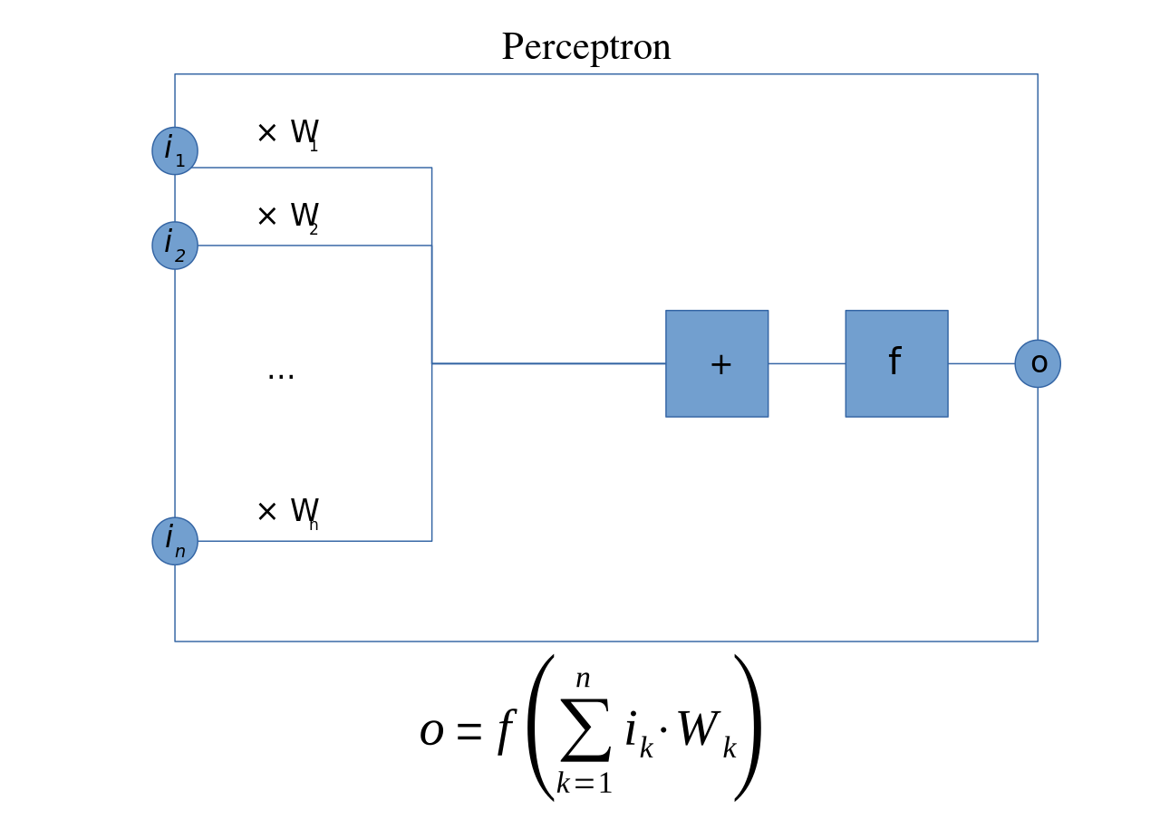

The appropriate weights are applied to the inputs and the sum( ) is passed to the function to produce output O
=============================================================================
WWW.THEMLLABS.COM || contact@themllabs.com || Phone : 91-7338339898, 91-6362546088

Slide 8
Convergence
The convergence of a perceptron depends on the training set.
If the training set are linearly separable, it will definitely converge.
If the training set are non-linearly separable, it will never converge.
The support vector machines can solve this problem.
=============================================================================
WWW.THEMLLABS.COM || contact@themllabs.com || Phone : 91-7338339898, 91-6362546088

Slide 9

Multiclass perceptron
In multi class perceptron, a function maps each input to a finite-dimensional featured vector.
The input and output are drawn from arbitrary sets
The function used is:
=============================================================================
WWW.THEMLLABS.COM || contact@themllabs.com || Phone : 91-7338339898, 91-6362546088

Slide 10

Similarly, the update function changed to:
This perceptron can be made as original perceptron, when x is real valued, and y is taken in the range {0, 1} and f(x) = yx.
=============================================================================
WWW.THEMLLABS.COM || contact@themllabs.com || Phone : 91-7338339898, 91-6362546088

Slide 11
Thank you
=============================================================================
WWW.THEMLLABS.COM || contact@themllabs.com || Phone : 91-7338339898, 91-6362546088

